Slide 1

Automotive Technology: A Systems Approach, 8e
Chapter 49: Wheel Alignment
Rob Thompson and Jack Erjavec, Automotive Technology: A Systems Approach, 8th Edition. © 2025 Cengage. All Rights Reserved. May not be scanned, copied or duplicated, or posted to a publicly accessible website, in whole or in part.

Slide 2
Chapter Objectives
49.01 Explain the types of wheel alignment.
49.02 Explain the importance of correct wheel alignment angles.
49.03 Describe the different functions of camber and caster with regard to the vehicle’s suspension.
49.04 Identify the purposes of steering axis inclination.

Slide 3
Chapter Objectives
49.05 Explain why toe is the most critical tire wear factor of all the alignment angles.
49.06 Identify the purposes of turning radius or toe-out in turns.
49.07 Explain the conditions known as tracking and thrust angle.
49.08 Perform a prealignment inspection.

Slide 4
Chapter Objectives
49.09 Explain how to use wheel alignment tools and equipment.
49.10 Describe how alignment angles can be changed on a vehicle.
49.11 Understand the importance of rear-wheel alignment.
49.12 Identify and understand steering sensor calibration requirements.

Slide 5
Wheel Alignment
49-02 Explain the importance of correct wheel alignment angles.
Correct alignment allows the wheels to roll without scuffing, dragging, or slipping.
This ensures greater safety, easier steering, and longer tire life.
The alignment should be checked when new tires are installed, or when the tires are wearing abnormally.

Slide 6
Types of Wheel Alignment
49-01 Explain the types of wheel alignment.
Two-Wheel
  Only the angles of the front wheels are measured and adjusted.
Four-Wheel
  Angles measured at all four wheels even if only the front are adjusted

Slide 7
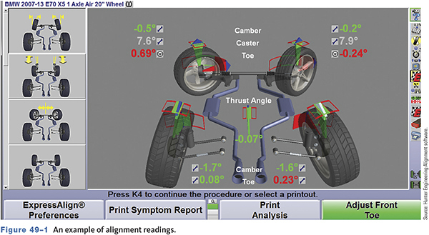
Alignment Readings

Slide 8
Alignment Geometry—Caster
49-03 Describe the different functions of camber and caster with regard to the vehicle’s suspension.
Caster
  The angle of the steering axis of a wheel from the vertical, as viewed from the side of the vehicle
  Provides steering stability
  Not related to tire wear
  Affected by worn ball joints, strut rods, and control arm bushings

Slide 9
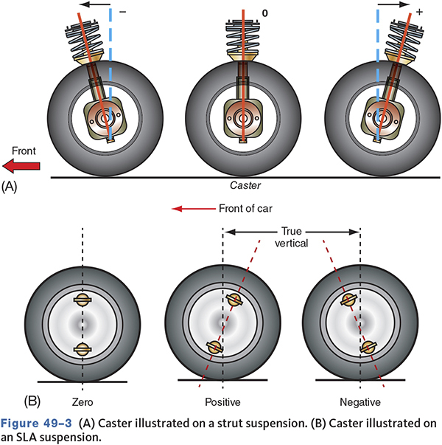
Caster

Slide 10
Alignment Geometry—Camber
Camber
  The angle represented by the tilt of either the front or rear wheels inward or outward from the vertical, as viewed from the front of the car
  Can cause tire wear and pull to the most positive side
  Affected by springs, ball joints, control arm bushings, and wheel bearings

Slide 11
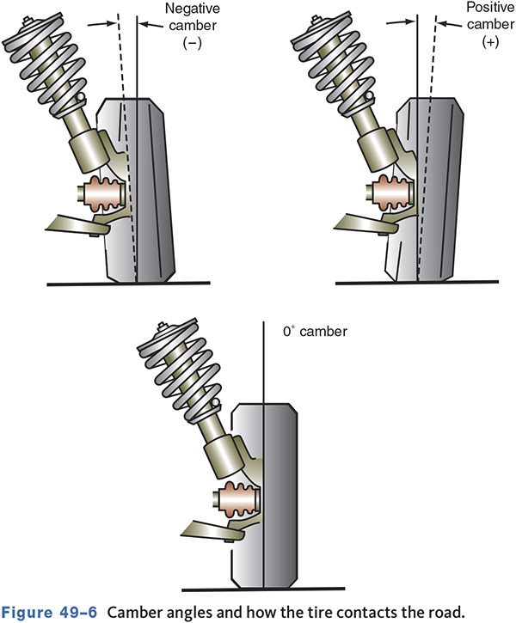
Camber

Slide 12
Alignment Geometry—Toe
49-05 Explain why toe is the most critical tire wear factor of all the alignment angles.
Toe
  The distance comparison between the leading edge and trailing edge of the front tires
  Most critical tire wear angle
  Must be adjusted evenly on each side
  Incorrect toe can cause the steering wheel to be off-center

Slide 13
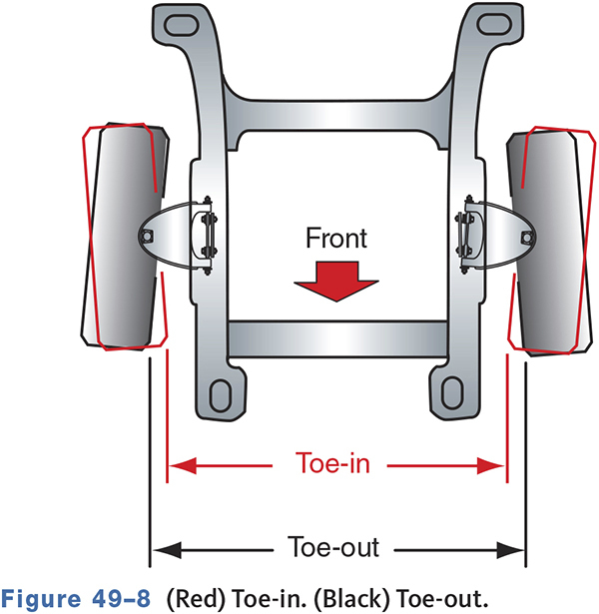
Toe

Slide 14
Thrust Line Alignment (1 of 2)
49-07 Explain the conditions known as tracking and thrust angle.
The rear of the vehicle should track directly behind the front tires.
If rear toe is not parallel to the vehicle centerline, a thrust direction to the left or right is created.
The difference of rear toe from the centerline is called the thrust angle.

Slide 15
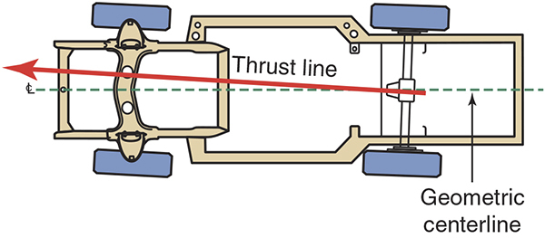
Thrust Line Alignment (2 of 2)

Slide 16
Alignment Angles—SAI
49-04 Identify the purposes of steering axis inclination.
Steering Axis Inclination (SAI)
  The angle between true vertical and a line drawn between the steering pivots
  FWD usually have high SAI (12 to 18 degrees).
Included Angle
  The sum of the SAI and the camber

Slide 17
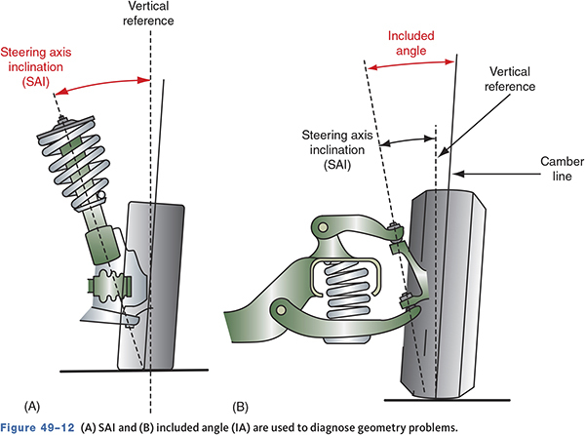
SAI and Included Angle

Slide 18
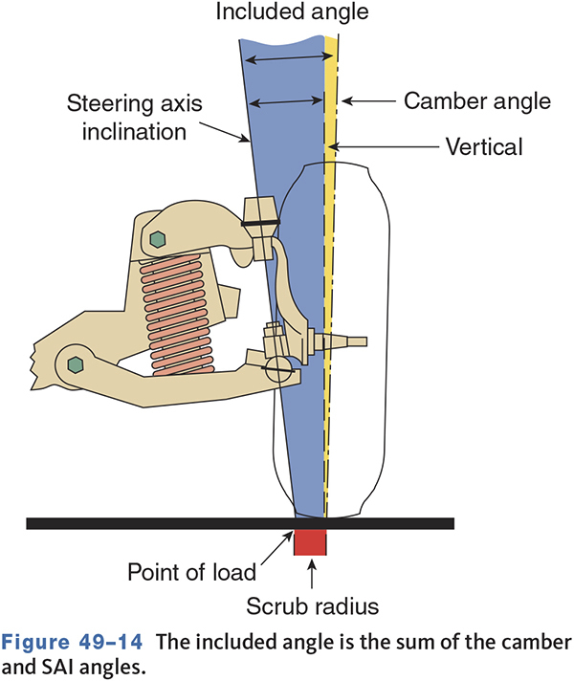
Alignment Angles—Scrub Radius
Scrub Radius
  The distance between the center of the tire and where SAI intersects the ground
  Must be equal on both sides
  Most FWD vehicles have a negative radius to reduce torque steer

Slide 19
Turning Radius
49-06 Identify the purposes of turning radius or toe-out in turns.
The amount of toe-out present in turns
Also called toe-out on turns or turning angle
Eliminates tire scrubbing while cornering
Built into steering geometry
Not adjustable

Slide 20
Toe-Out On Turns (1 of 2)
Also called turning angle
Designed by placement of the steering arms and linkage
Reduces tire scrubbing while cornering

Slide 21
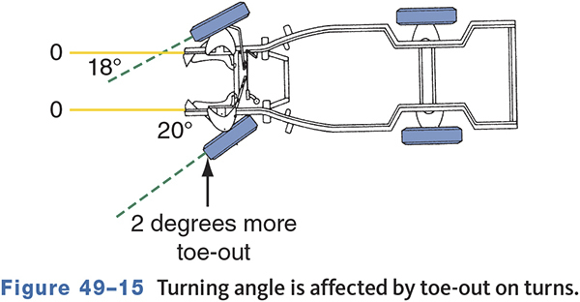
Toe-Out On Turns (2 of 2)

Slide 22
Knowledge Check (1 of 2)
Which three alignment angles are typically adjusted during a wheel alignment?

Slide 23
Knowledge Check Answer (1 of 2)
Which three alignment angles are typically adjusted during a wheel alignment?
Answer: Caster, Camber, and Toe

Slide 24
Load Distribution
The load placed on each wheel
Each wheel must carry the correct amount of weight at its designed ride or trim height.
Excessive loading changes ride height, vehicle balance, and steering geometry.
Weak springs and bent suspension parts can affect this condition.

Slide 25
Prealignment Inspection
49-08 Perform a prealignment inspection.
Know why the vehicle needs aligned or why an alignment is requested
Follow the customer interview with a test drive
Note vibrations, pulling, hard steering, tire squeal, or noises
If any parts are found to be defective, they should be replaced before proceeding with the alignment.

Slide 26
Ride Height
Check vehicle ride height against the specifications
Proper alignment is not possible if ride height is incorrect.
Ride height is discussed in detail in Chapter 16.

Slide 27
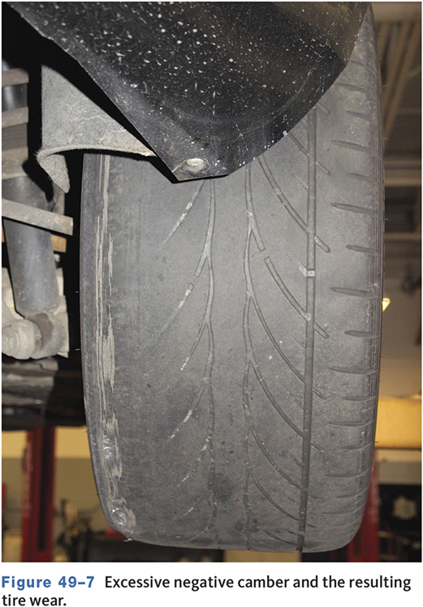
Results of Poor Alignment
Often causes
  Pulling
  Accelerated tire wear
  Wander
  Instability
  Poor steering return
  Tire squealing

Slide 28
Effects of Incorrect Alignment (1 of 2)
Incorrect camber setting
  Tire wear
  Ball joint/wheel bearing wear
  Pull to side of most positive/least negative camber
Too much positive caster
  Hard steering
  Excessive road shock
  Wheel shimmy
Too much negative caster
  Wander
  Weave
  Instability at high speeds

Slide 29
Effects of Incorrect Alignment (2 of 2)
Unequal caster
  Pull to side most negative/ least positive caster
Incorrect SAI
  Instability
  Poor return
  Pull to side of lesser inclination
  Hard steering
Incorrect toe setting
  Tire wear
Incorrect turning radius
  Tire wear
  Squeal in turns

Slide 30
Wheel Alignment Equipment (1 of 3)
Modern systems are computerized.
Many use LEDs and CCD cameras to determine wheel position.
Notes:
This was one slide—split to two. Too crowded for this list.

Slide 31
Wheel Alignment Equipment (2 of 3)
Alignment information is displayed on screen and can be printed for the customer.
Alignment equipment and racks need maintenance and care to provide reliable service.

Slide 32
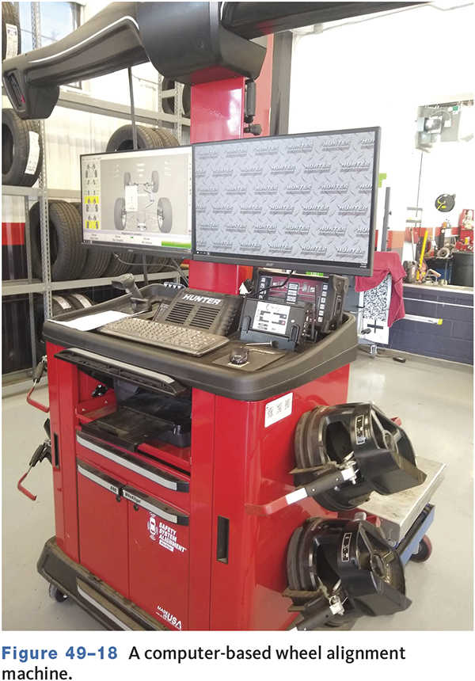
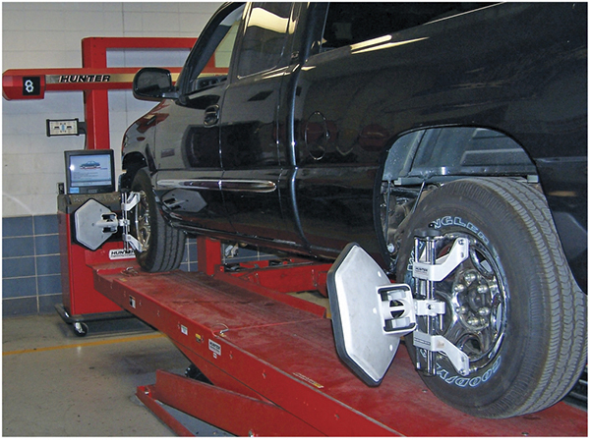
Wheel Alignment Equipment (3 of 3)

Slide 33
Alignment Machines
Modern machines provide
  Model-specific information and photos
  Caster, camber, SAI, IA, setback, and toe readings
  Printed analysis
  Displays tools and parts for adjustments
  Steps for shim placement

Slide 34
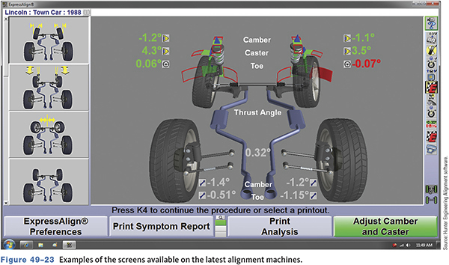
Screenshot from Alignment Machine

Slide 35
Knowledge Check (2 of 2)
Technician A says incorrect caster will cause rapid tire wear. Technician B says incorrect toe can cause rapid tire wear. Who is correct?

Slide 36
Knowledge Check Answer (2 of 2)
Technician A says incorrect caster will cause rapid tire wear. Technician B says incorrect toe can cause rapid tire wear. Who is correct?
  Answer: Technician B Only

Slide 37
Two-Wheel Alignment
Aligns the front wheels to the geometric centerline
Assumes the rear wheels are square
Cannot set the front wheels parallel to the rear

Slide 38
Four-Wheel Alignment
Sets all four wheels straight ahead with the steering wheel centered
Nearly, all new vehicles require all four wheels to be aligned.
Rear wheels are set first.

Slide 39
Performing an Alignment
49-10 Describe how alignment angles can be changed on a vehicle.
All angles are interrelated.
Adjust in order—caster, camber, toe
Some alignment machines require wheel units (heads) to be compensated.
Set angles to manufacturers specifications
Usually, specs include a preferred setting and minimum/maximum allowances.

Slide 40
Methods Used to Adjust Caster and Camber
Shims
Eccentrics and shims
Slotted frame
Rotating ball joint

Slide 41
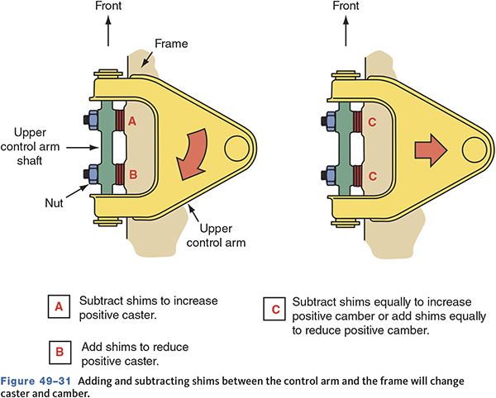
Caster/Camber Adjustment (1 of 3)

Slide 42
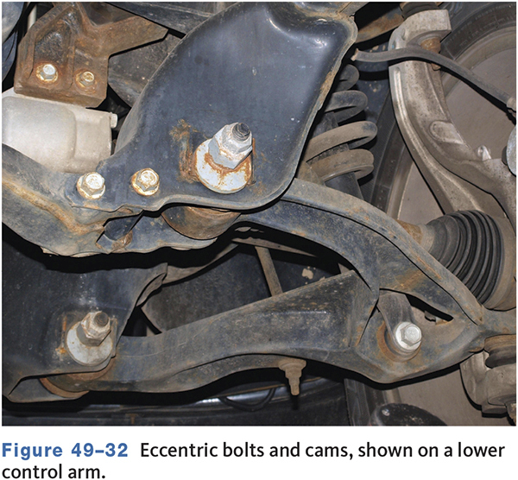
Caster/Camber Adjustment (2 of 3)

Slide 43
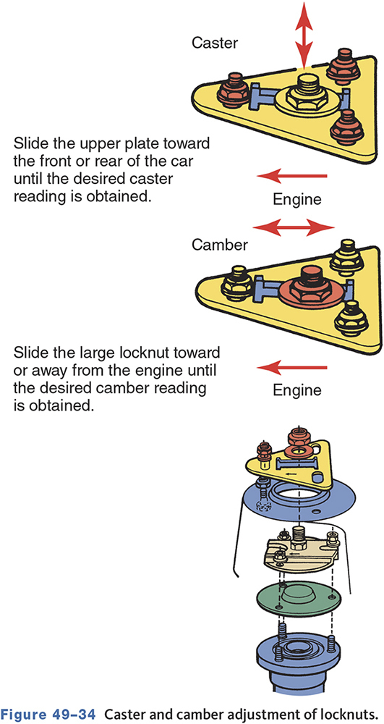
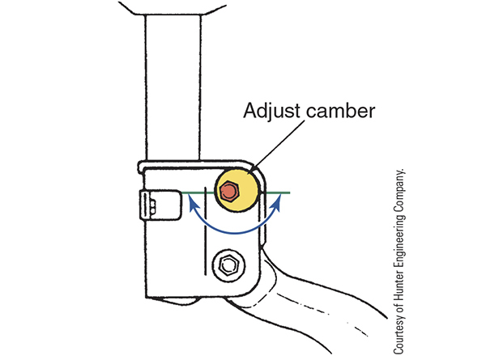
Caster/Camber Adjustment (3 of 3)

Slide 44
Toe Adjustments (1 of 2)
The last adjustment to be set
Make sure the steering wheel is centered and locked in place.
Ideal toe is both tires perfectly straight ahead.
Rear toe is as critical as front wheel toe.

Slide 45
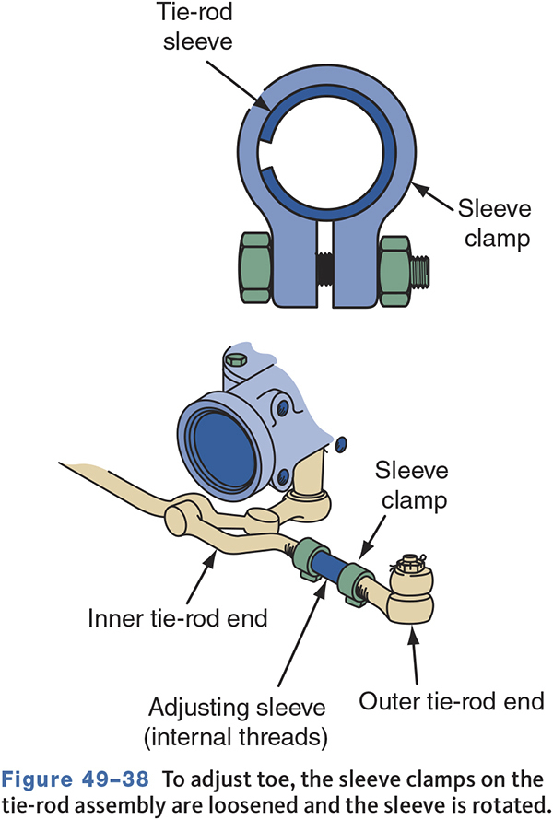
Toe Adjustments (2 of 2)

Slide 46
Thrust Line
49-11 Understand the importance of rear-wheel alignment.
If rear toe is incorrect or a wheel is set back, the thrust line will be off-center.
Setting rear toe should set thrust angle and steering wheel correctly.
If rear toe cannot be set, align the front wheels to the thrust line.

Slide 47
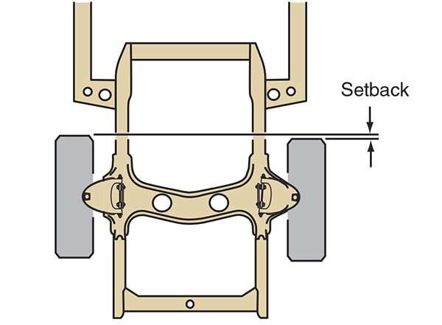
Setback
Typically caused by a bent component or a misadjusted cradle
If slight, the difference can be compensated for during alignment.

Slide 48
4WD Vehicle Alignment
Most 4WD vehicles do not have an adjustable caster.
Aftermarket kits may be available to set caster.
Camber may be adjustable using shims between the steering knuckle and spindle.

Slide 49
Steering Angle Sensor Calibration (1 of 2)
49-12 Identify and understand steering sensor calibration requirements.
Many late-model vehicles with electronic stability control require sensor calibration after steering/suspension service or wheel alignment.
The alignment machine may be able to calibrate or a scan tool may be necessary.
Failure to calibrate may case ESC problems.

Slide 50
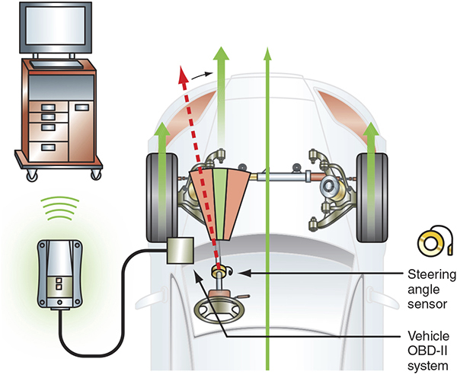
Steering Angle Sensor Calibration (2 of 2)

Slide 51
Chapter Reflection
Write down a concept from this chapter that challenged you. Describe what made the concept difficult for you and the steps you took to improve your understanding.
How could you help another learner who was struggling with the same concept?
Use 100–150 words in your answer.

